Slide 1
Lessons learned from assessing the water-food-energy-ecosystems nexus: approaches, findings and possible responses
CAEF, 5-7 June, Ashgabat, Turkmenistan
International Nexus practices and implications for Central Asia
Boris Erg, Director IUCN ECARO
James Dalton, a.i. Director IUCN Global Water Programme

Slide 2



What is IUCN?
Effective delivery
Around 950 staff in more than 50 countries
Global convener 1283 Members in 161 countries
Trusted Knowledge 16,151
experts in six Commissions
www.iucn.org

Slide 3
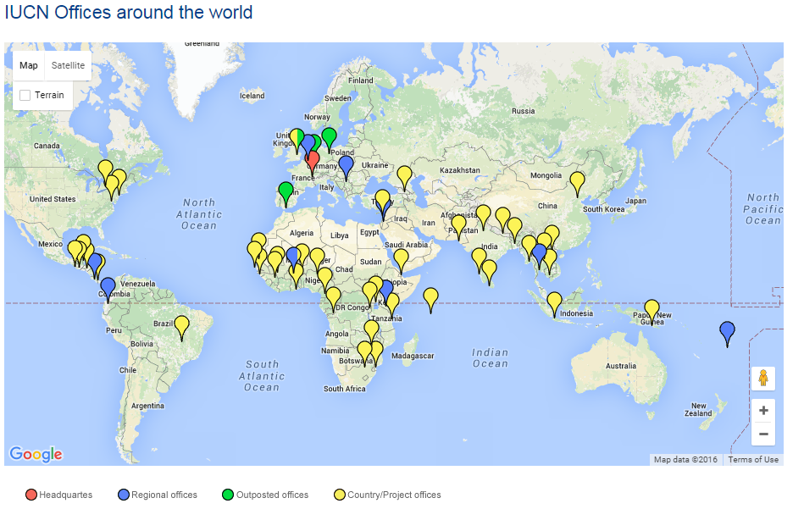
IUCN offices across the world
www.iucn.org

Slide 4

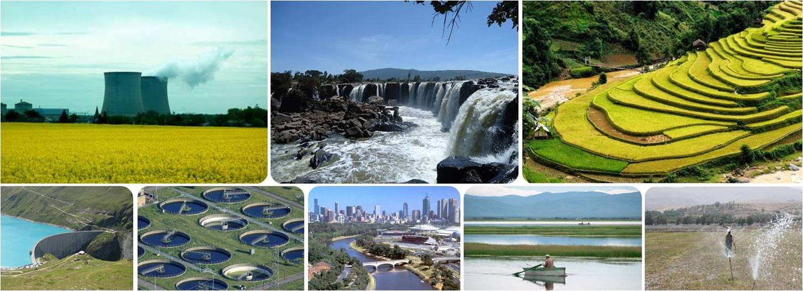
The Dialogue Partnerships for innovation in water, energy and food security
2012 – and onwards…. waternexussolutions.org
www.iucn.org
Notes:
4

Slide 5
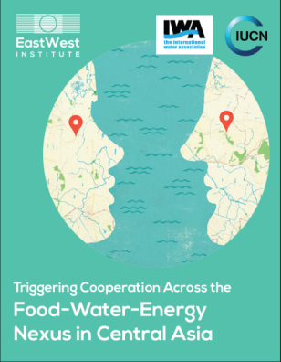


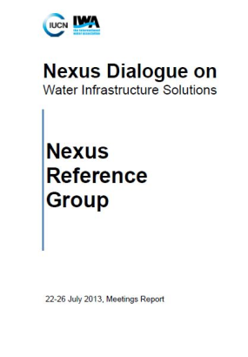


Core Anchor Workshops
CENTRAL ASIA
JULY 2014
ASIA
March 2014
LATIN AMERICA
September 2013
AFRICA
May 2013
www.iucn.org
Notes:
5

Slide 6

Information sharing
www.iucn.org
Notes:
6

Slide 7


Dialogue Synthesis Papers
www.iucn.org
Notes:
7

Slide 8




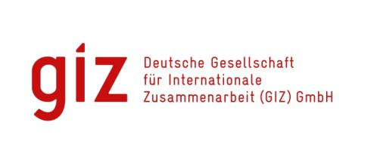
Experiences from Latin America
www.iucn.org
Notes:
8

Slide 9


Water, Agri and Energy Nexus in Africa
Phases A and B (i) finished
Discussing implementation of Phase B (ii) before end of 2017
www.iucn.org
Notes:
9

Slide 10
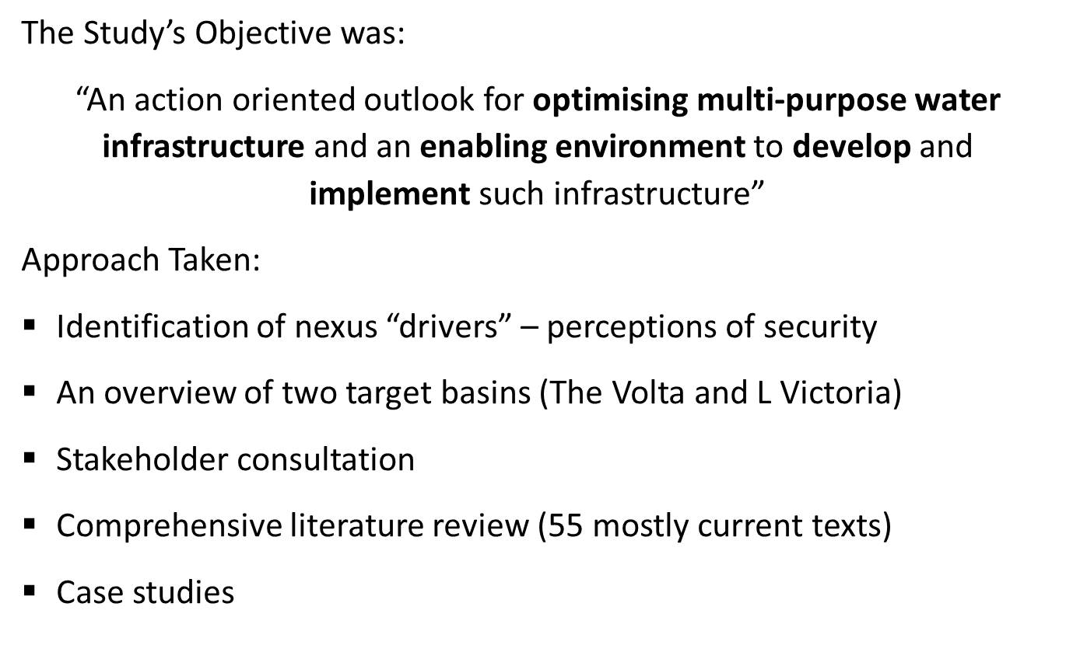
Study focus
www.iucn.org
Notes:
10

Slide 11
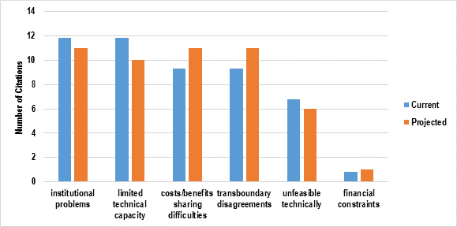
Main findings
www.iucn.org
Notes:
11
Silo and linear thinking
political economy
static mindsets
donor drag

Slide 12
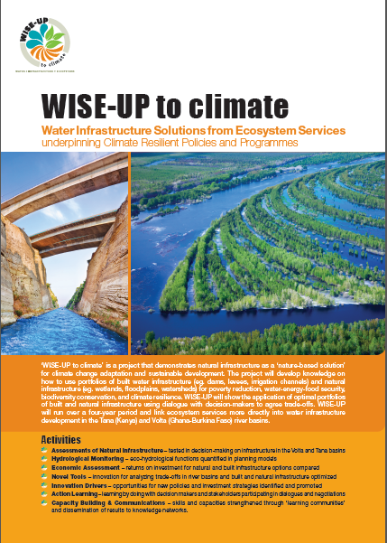
Shared basin vision approach
Adaptive capacity increased through:
recognition and inclusion of ecosystem services provided by natural infrastructure in investment strategies for climate change adaptation and through
optimisation with built infrastructure planning and development.
www.iucn.org
Notes:
12

Slide 13
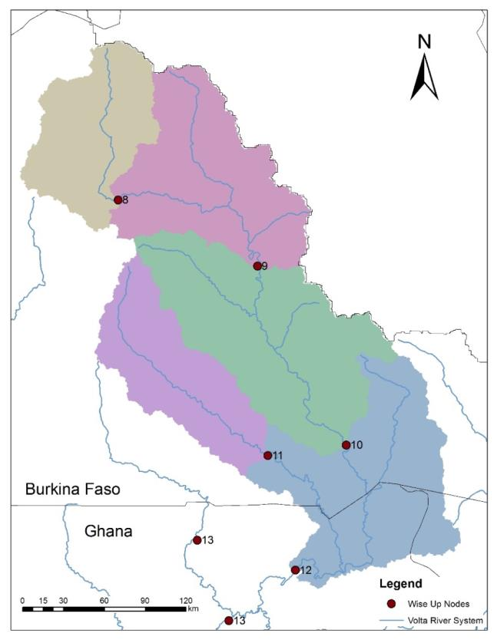
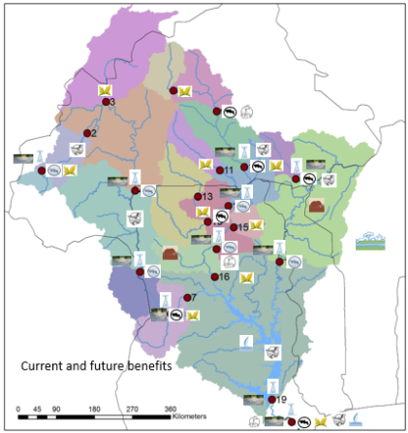














White Volta Basin system benefits
Ziga dam
Habitat
Bagre dam
Irrigation
Fisheries
Hydropower
Pwalugu dam
Domestic and urban water supply
Flood recession agriculture
www.iucn.org
Notes:
13

Slide 14
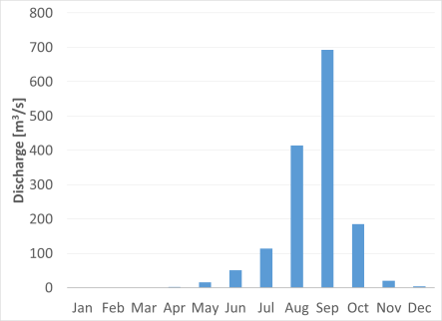
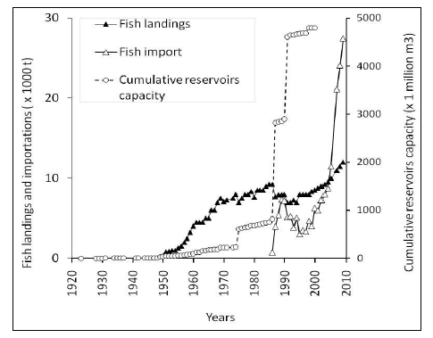
Ecosystem services and cost benefit analysis
Replenishing riparian ponds
Restocking fish in the ponds
Spawning grounds for river fish
Water for livestock
Rejuvenating natural vegetation
Construction materials
Calabash farming
Depositing fertile soils in the flood plain
Supporting agricultural production
Habitat functionality
Mainly benefiting riparian communities
Estimation of yields with fisheries
www.iucn.org
Notes:
14

Slide 15
Lower Mekong Initiative: Nexus Futures Programme
Vietnam, Laos, Cambodia – supported by the IUCN Building River Dialogue and Governance (BRIDGE) – SDC financed 9 yr programme
Stream 1: preparation of a Nexus assessment
Stream 2: nexus assessment will inform decision making processes, training programmes for central and provincial government officials in 3 countries, and development planning overlay
Stream 3: tailored regional dialogues with all Lower Mekong countries targeting diplomatic and economic regional platforms, media engagement, technical tool for economic cooperation using BRIDGE methodologies
www.iucn.org
Notes:
15

Slide 16
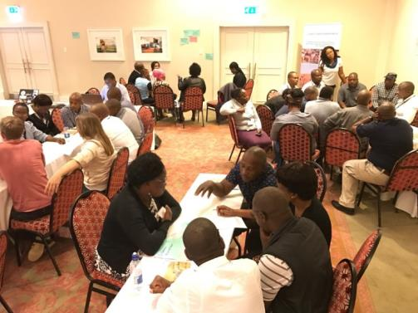
Orange-Senqu River Basin
Transition and transformation of the Orange-Senqu River Commission (ORASECOM) from a river basin advisory body to the Orange-Senqu Basin Authority.
Main obstacles:
‘Silo’ mentality within and across sectors
Aspirations for independent national water, energy and food security
Legacy issues (e.g. mines, dams and people)
Theory of change
Demand-driven planning and management process
Rangeland degradation and management
Water as an economic good*
Institutional/policy reform & enforcement
www.iucn.org
Notes:
16

Slide 17
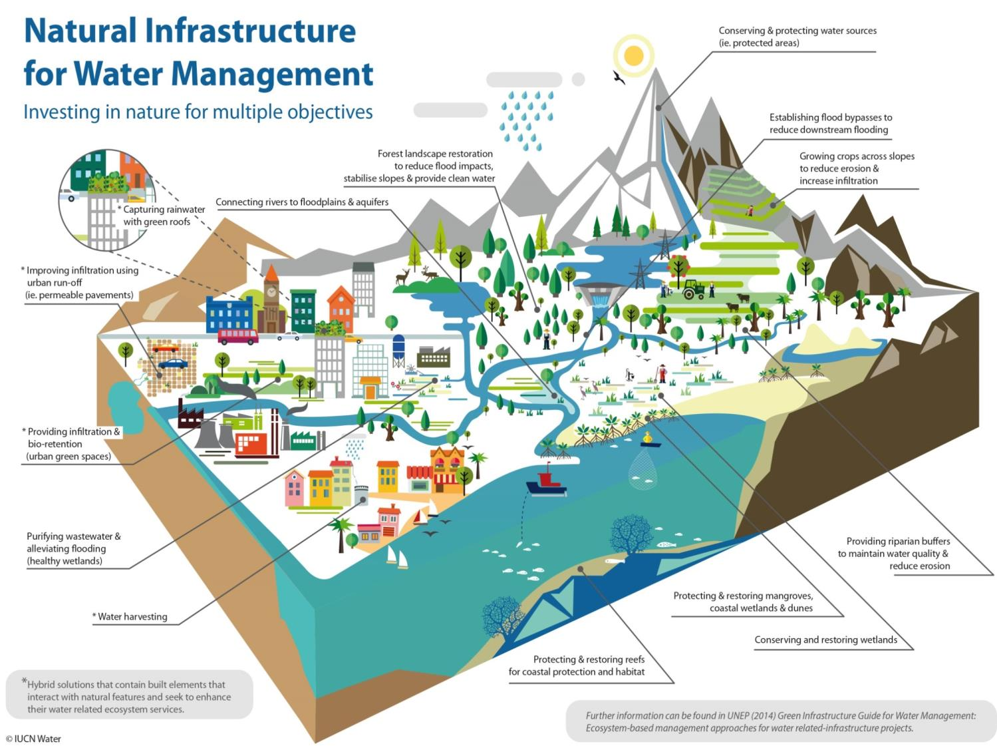

Slide 18
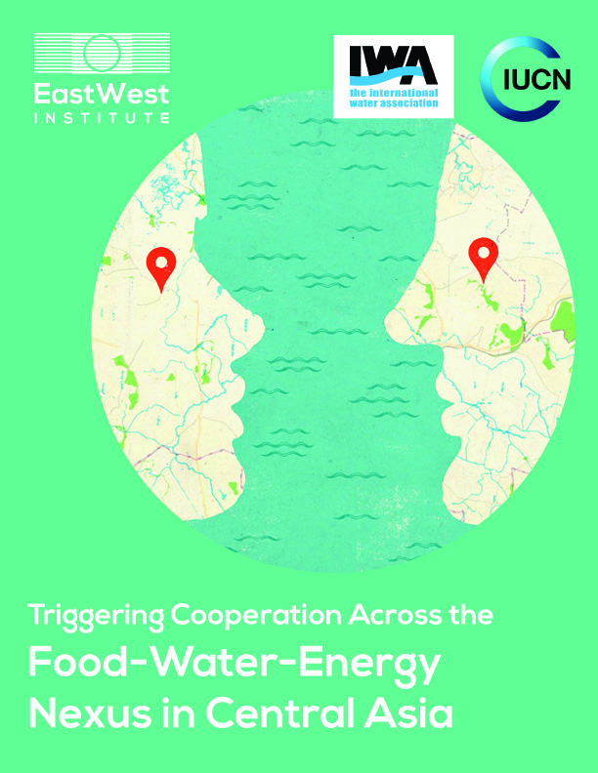
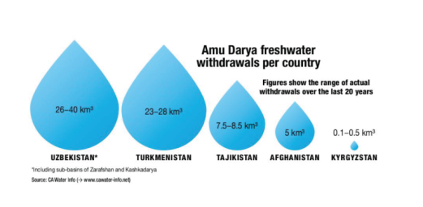
Central Asia Nexus – Amu Darya in focus
www.iucn.org
Notes:
18

Slide 19
Amu Darya Nexus – ways forward
Improve cooperation of the riparian countries in ensuring a full scale of ecosystem services through innovative payments schemes
Establish mechanisms at regional and national level to achieve a transparent, integrated, harmonized, up-to-date basin-wide information system
Promote the benefits of cooperation by strengthening economic integration and development – with a view to improving natural resource management and equitable governance
Raise the professional skills of specialists, farmers and water user associations, through professional training centers
Establish a network of knowledge and innovation centers to improve cooperation on WEF Nexus at regional and national levels
www.iucn.org
Notes:
19

Slide 20
Achieving success in Central Asia
To render support to Central Asian countries in sustainable development and regional cooperation
To create a multi-sectoral enabling environment to facilitate sustainable and climate-resilient investments for increased WEF security
Nexus priority issues and possible responses and solutions at national and regional level are identified and prioritized
Regional institutions and capacities for multi-sectoral planning are strengthened
A list of WEF investment projects is established within a Nexus policy framework
Working directly with national governments, civil society and business to construct programmes for scaling up impacts
Negotiating solutions– so change and benefits can be accepted by all
www.iucn.org
Notes:
20

Slide 21
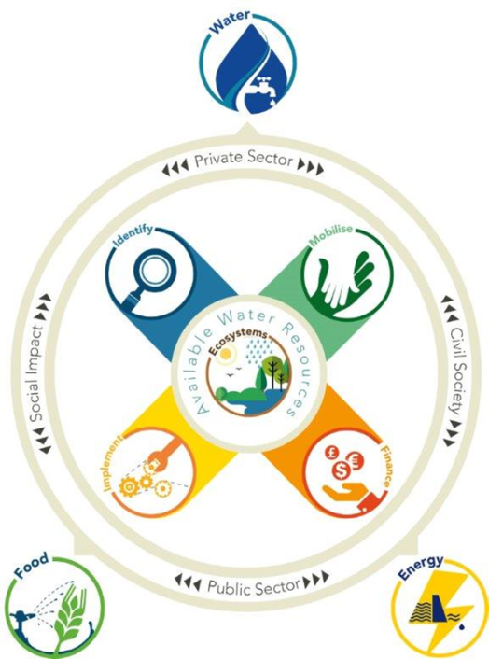
Stakeholder-based approach
Stakeholder roles
Private sector - securing production materials; markets
Public sector – maintaining (sustainable economic growth); peace and security
Civil society – ensuring equitable and sustainable access to resources
Social impact - investors with social and environmental concerns using different approaches (e.g. water funds)
Moving to action
Identifying a common problem
Mobilising partners
Securing financing
Implementing on the ground (and scaling up)
www.iucn.org
Notes:
21

Slide 22
Framework for action
Framing: What is the problem to be addressed? Scope; Context & Scale; Stakeholders
Opportunity: What is the opportunity for joint action and how can this be encouraged?
Robustness: What is the capacity of the regulatory/incentive framework(s) to effectively control the different uses?
Convergence: Is there any coordination (within the sector – and between sectors) in prioritizing what is required?
Effectiveness: What is the effectiveness of a multi-sector approach?
www.iucn.org
Notes:
22

Slide 23
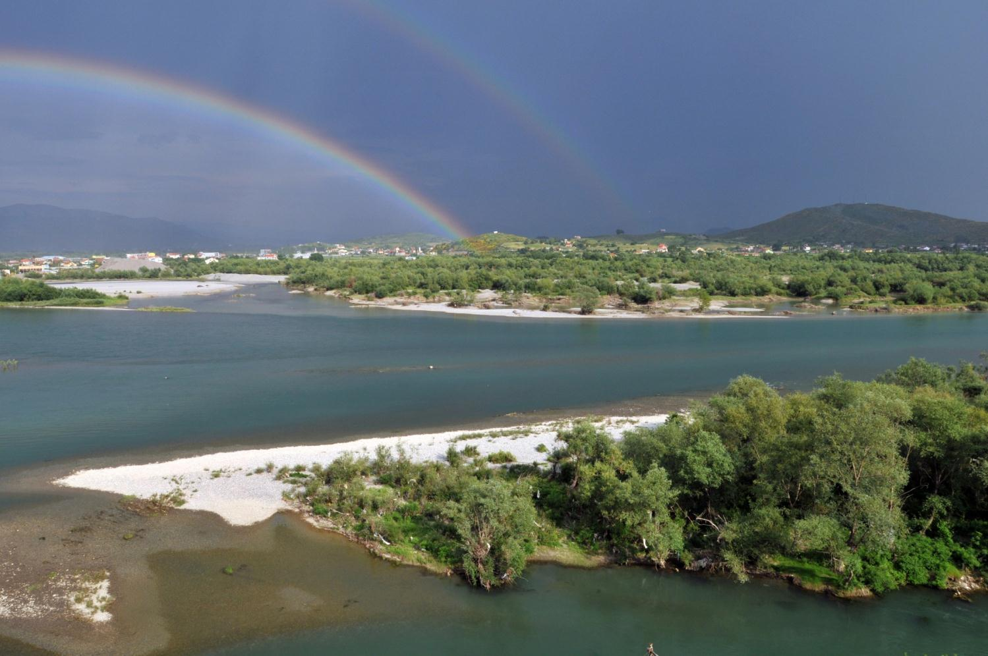
Thank you!
More information:
www.waternexussolutions.org
www.iucn.org
Notes:
23

